Slide 1
Eid Health Survey Campaign: BRAC & Lifebuoy Initiative

Slide 2
Website & FB
Reach
3.09 M+
Participants
320,781

Slide 3
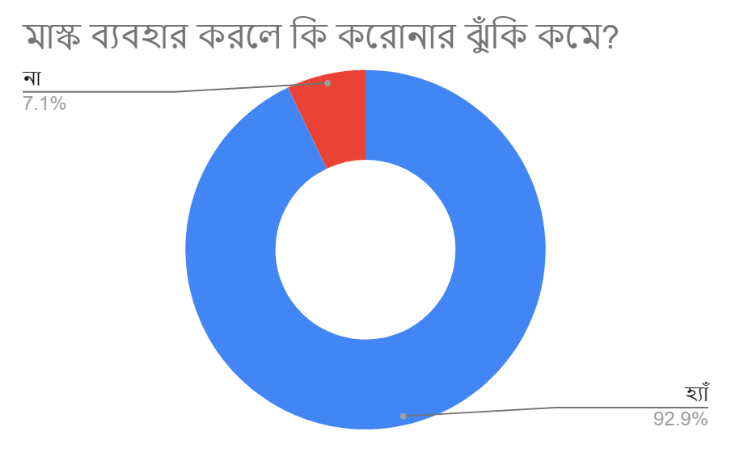
Q: 01
Do you think masks are likely to reduce the spread of COVID-19?
Yes | 92.90%
No | 7.10%

Slide 4
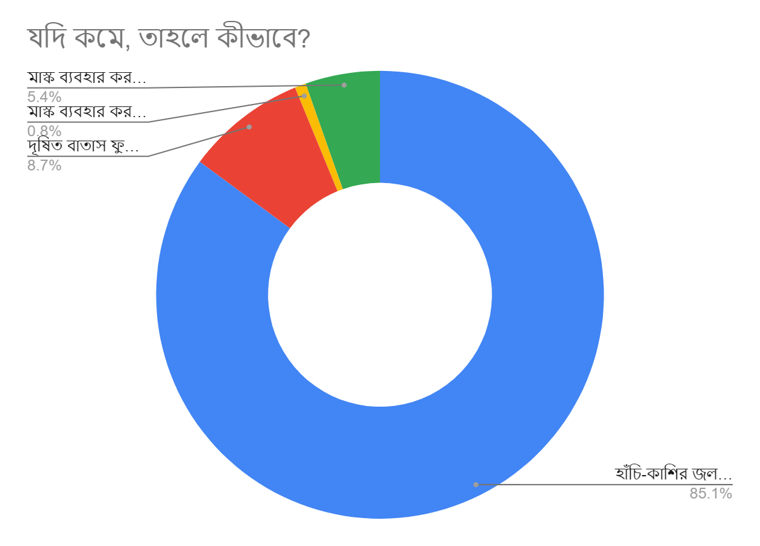
Q: 02
If you think masks reduce the spread of COVID-19, how does it work?
Masks help prevent respiratory droplets from traveling into the air and onto other people | 85.20%
Masks bar contaminated air from entering lungs | 8.70%
Do not know the effectiveness of wearing masks | 0.80%
Do not believe masks reduce the risks of COVID-19 spread | 5.40%

Slide 5
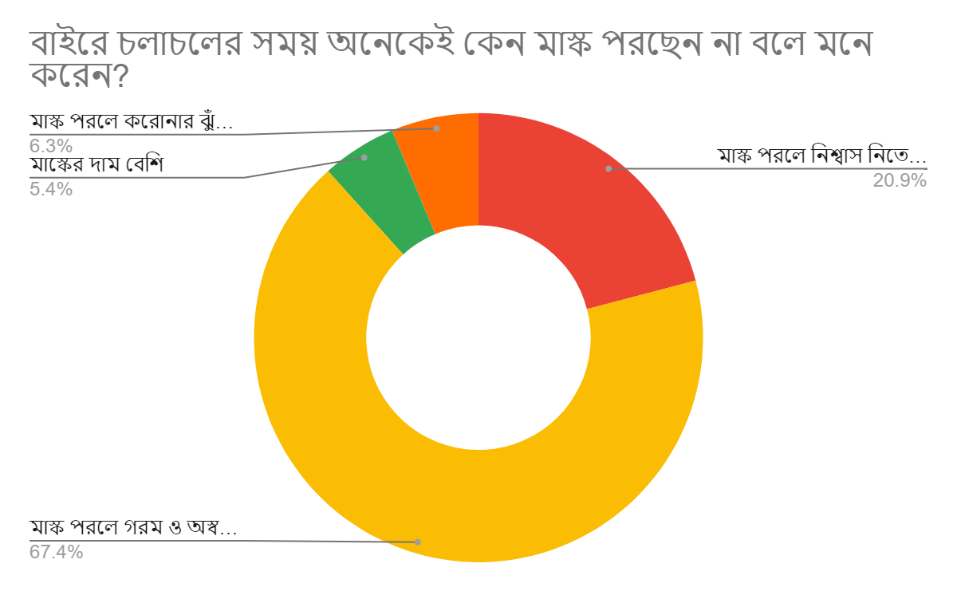
Q: 03
Why do you think many people refrain from wearing masks while in public setting?
Face difficulties in breathing | 20.90%
Feel hot and uncomfortable | 67.40%
Masks are costly | 5.40%
Masks do not really reduce the risks of spreading COVID-19 | 6.30%

Slide 6
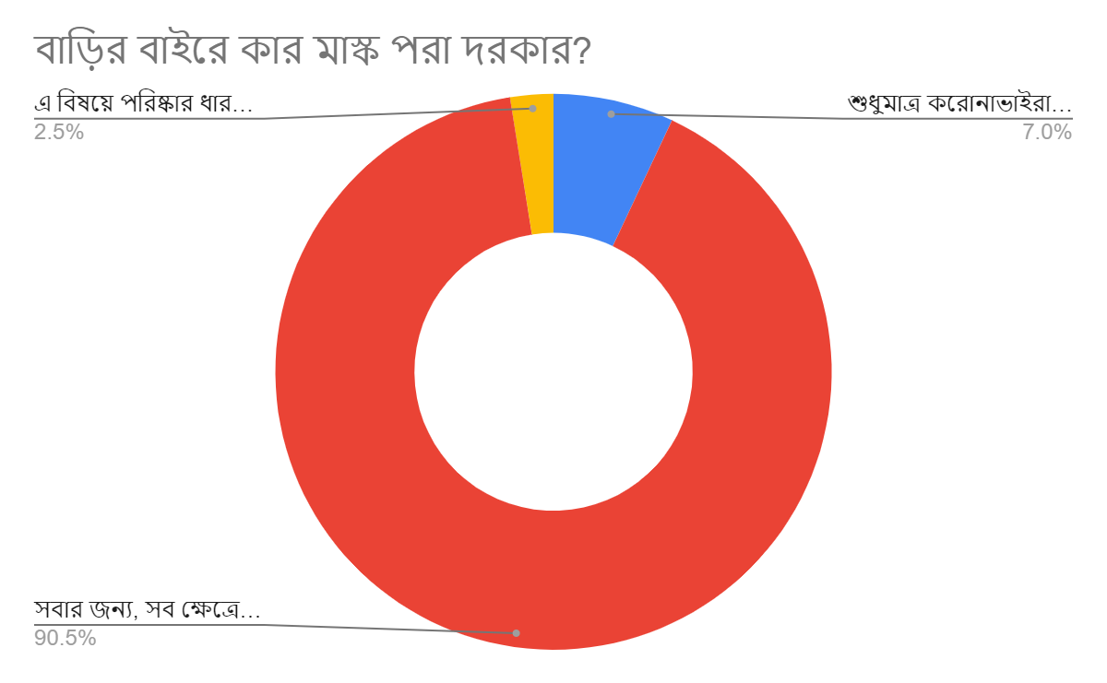
Q: 04
Who needs to wear mask in public setting?
Only those infected by COVID-19 | 7.00%
Mandatory for everyone to wear masks | 90.50%
No clear conception | 2.50%

Slide 7
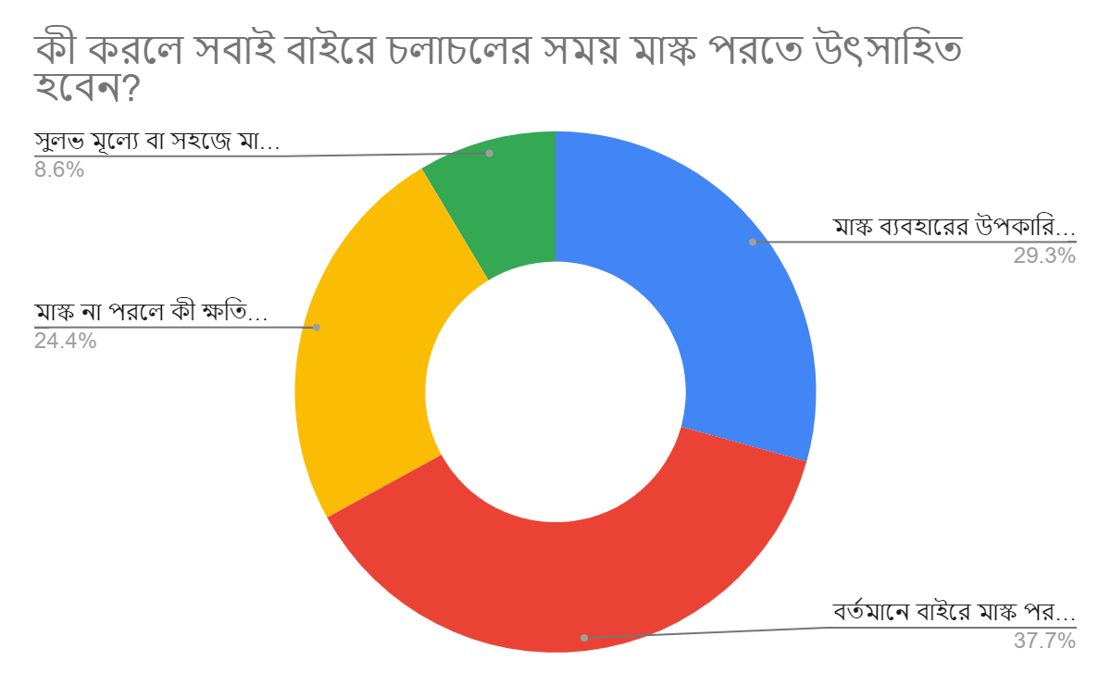
Q: 05
What can encourage everyone to wear masks while in public setting?
If they clearly get to know the benefits of wearing masks | 29.30%
If reminded of the provision that it is legally binding to wear masks while outside | 37.70%
Reminded of the disadvantages of not wearing masks | 24.40%
If masks are cheaper to buy | 8.60%

Slide 8
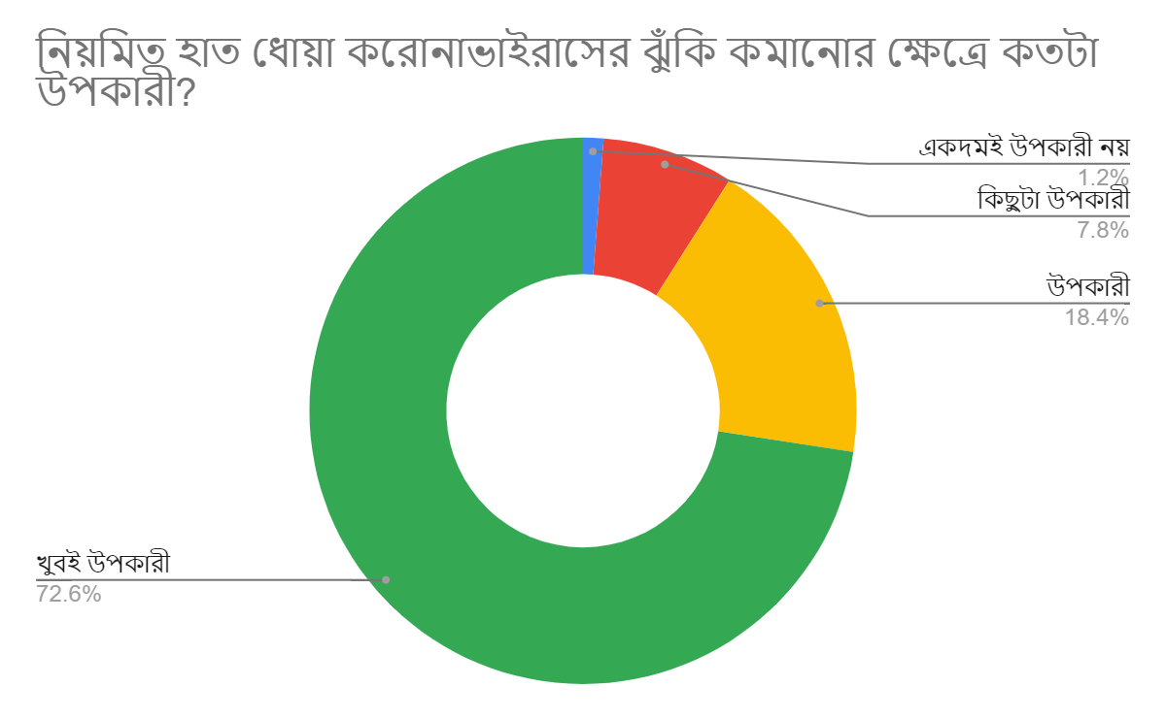
Q: 06
How beneficial hand-washing is to reduce the risks of contacting COVID-19?
Not beneficial at all | 1.20%
Slightly beneficial | 7.80%
Beneficial | 18.40%
Very beneficial | 72.60%

Slide 9
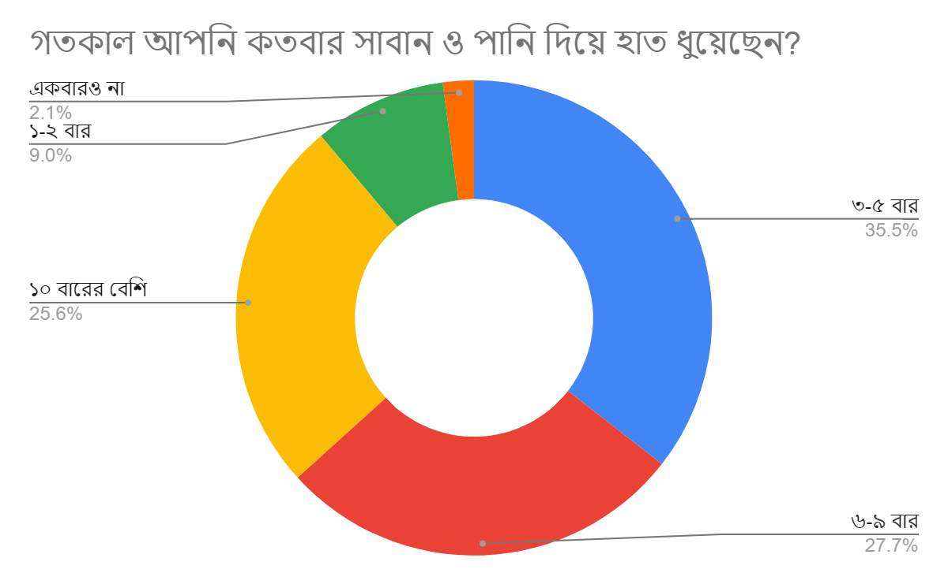
Q: 07
How many times did you wash your hands with soap and water yesterday?
3-5 times | 35.50%
6-9 times | 27.70%
More than 10 times | 25.60%
1-2 times | 9.00%
None | 2.10%

Slide 10
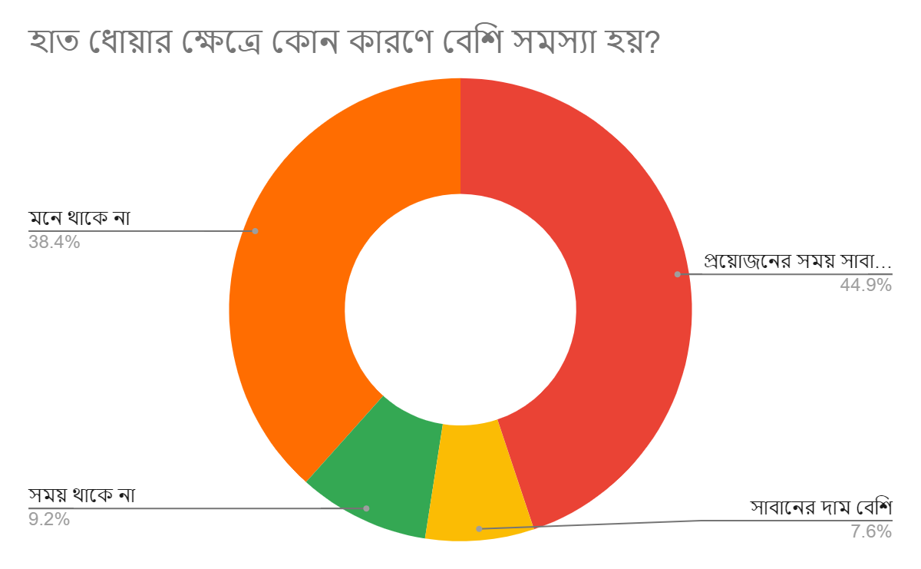
Q: 08
What are the factors mostly detrimental to washing hands?
Soap and water not available when needed | 44.90%
Soaps are costly | 7.60%
Do not have time | 9.20%
Do not remember | 38.40%

Slide 11
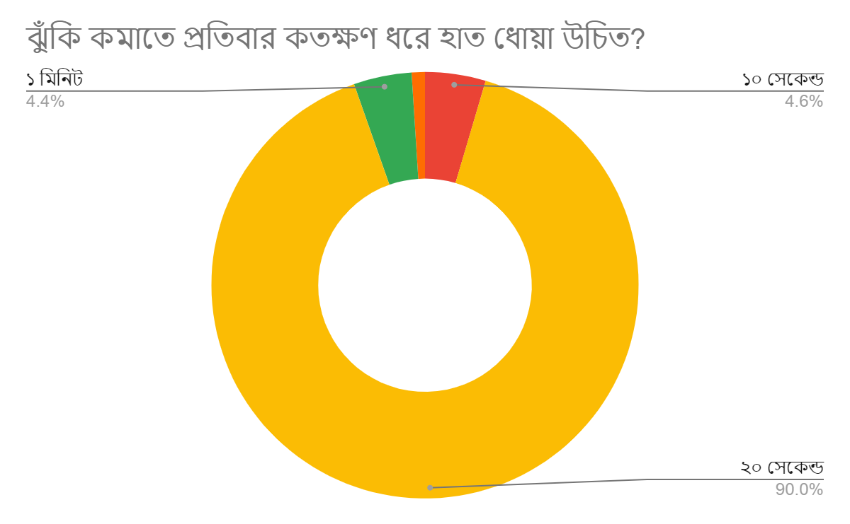
Q: 09
How long do people need to wash hands to reduce the risk of contacting COVID-19?
10 seconds | 4.60%
20 seconds | 90.10%
1 minute | 4.40%
5 minutes | 1.00%

Slide 12
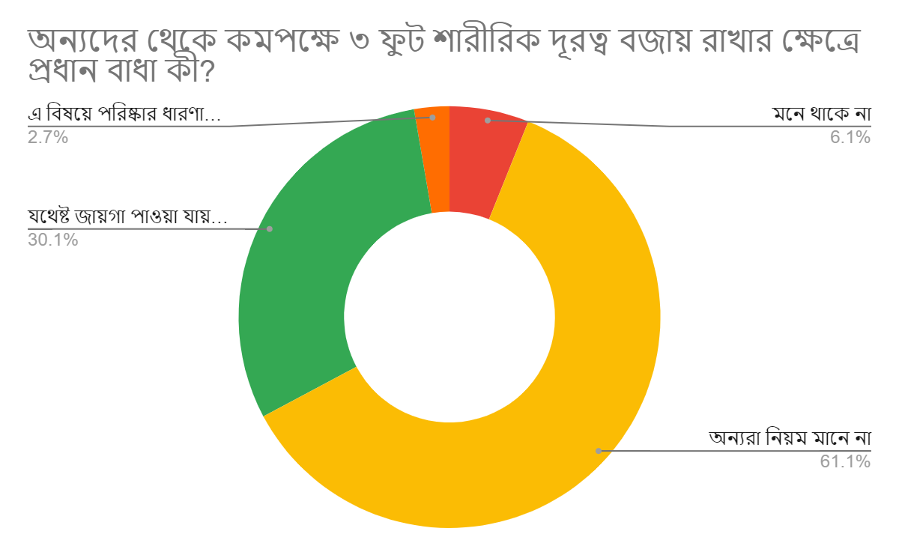
Q: 10
What bars people to maintain a minimum of 3-foot distance from each other?
Fail to remember | 6.10%
Others do not follow rule | 61.10%
Cant find enough space | 30.10%
Do not have clear conception on this | 2.70%

Slide 13
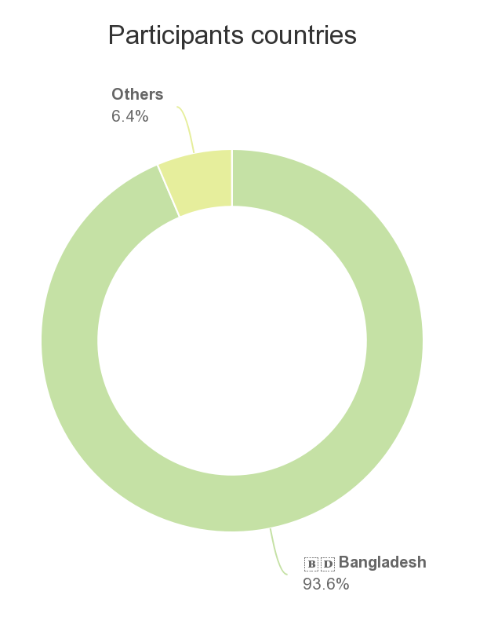
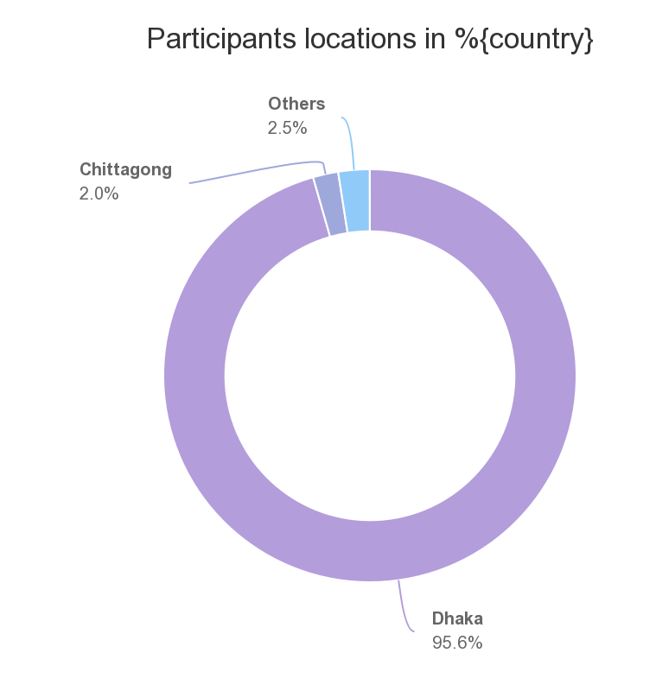
Location

Slide 14
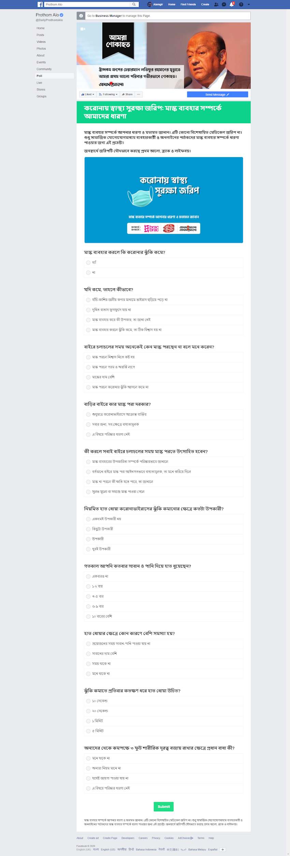
Screenshot

Slide 15
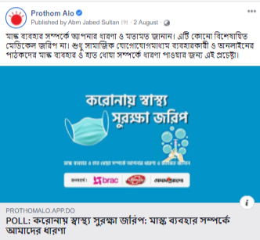
Screenshot

Slide 16
Prepared & Checked by Prothom Alo Digital
Bipasha Bala Shanta
Executive, Digital Marketing

